Slide 1
Plotting and Analyzing Concert Data with Songkick and Spotify’s APIs
Kaleb Tsegaye

Slide 2
Overview
A program for parsing concert/live performance data
To be used to provide insight on touring patterns specifically for less popular artists

Slide 3
Goals
Plot suggested path for an artist by providing a list of root artists to base results with
Examine if there is a relationship between demographic/socioeconomic factors in a venue’s census tract and the likelihood of a show appearing there
Hip-hop in four regions of United States: Midwest, South, West, East
Compiled a list of four or five artists from each region to use as root artists for my functions
Does not necessarily mean related artists are from these regions

Slide 4
Finding an optimal tour path
Function: optimal_path
Finds longest tour paths of multiple artists
Longest tour path - longest set of shows where date between two shows does not pass seven days
Classifies cities in the tour paths based on how many times they were visited by all of the artists
Green: the amount of shows tallied > (mean + 1.5*standard deviation)
Light green: amount > mean
Yellow: amount > (mean - 0.5*standard deviation)
Red represents the rest
Creates a path from city to city to display the locations of priority.
every green point is added in from the start
any other point that is within a cutoff distance between any two path points is added in.

Slide 5
1 km
Cutoff = 1.2
1.1 < 1.2, so point is added
.55
.55

Slide 6
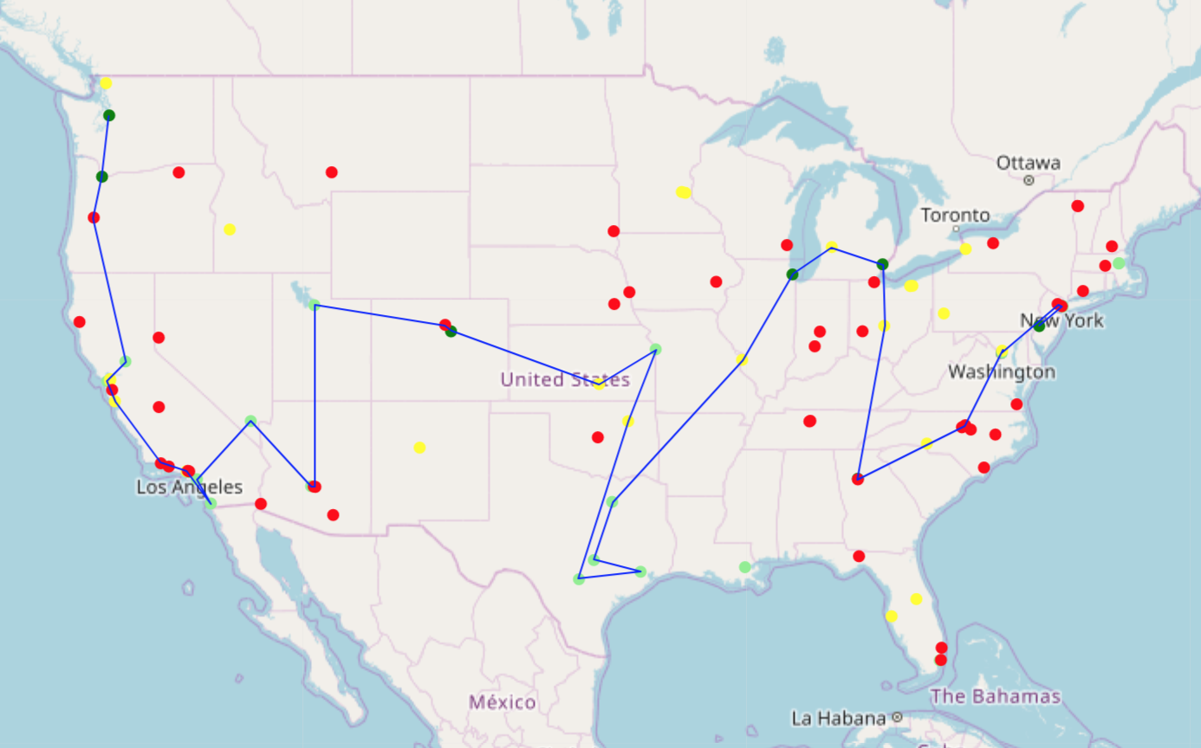
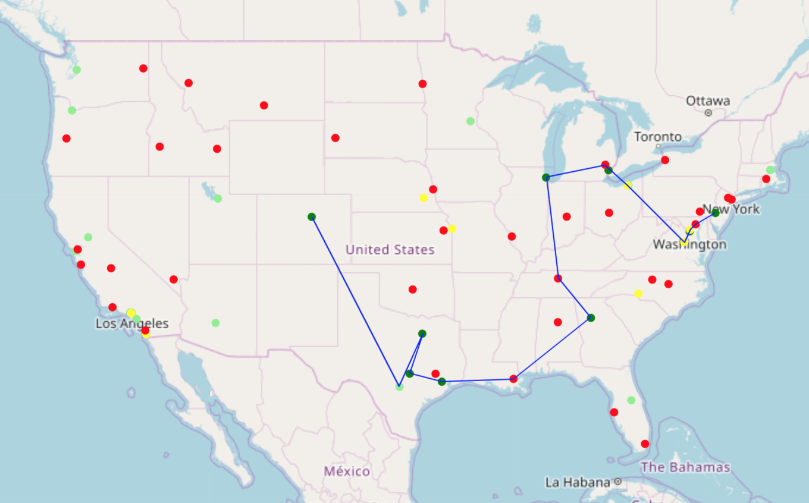
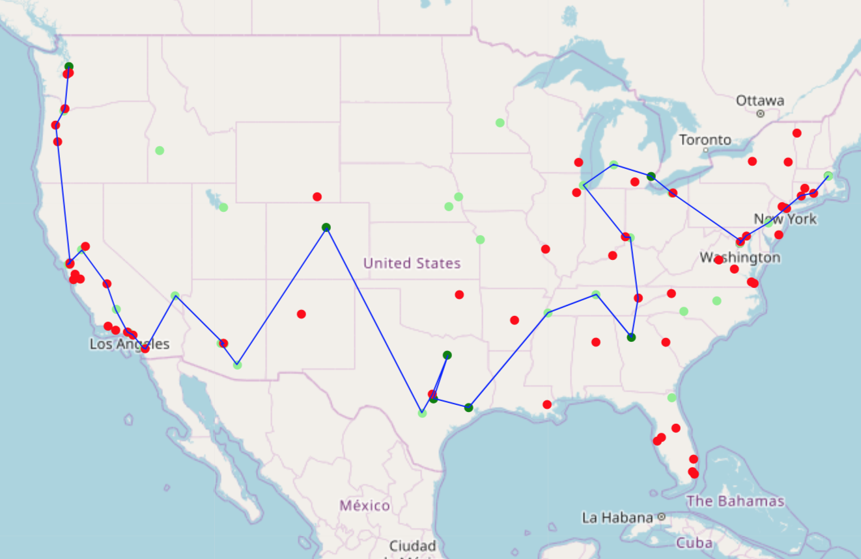
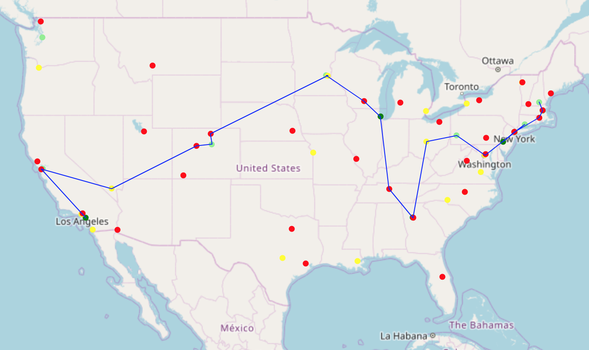
West
Midwest
Hip-hop
East
South

Slide 7
Finding relationships between tracts and show frequency
Three factors (that can be seen at tract level) that affect music taste: race, age, class
Common observation about hip-hop for past few decades: generally, the artists do not resemble majority of audience
Hypothesis: Event frequency will be higher in census tracts with 1) higher black population percentages, 2) lower median age, and 3) higher median household income

Slide 8
West | Coeff | Std Error | t | p-value
Black Pop % | -0.2077 | 0.399 | -0.521 | 0.604
Median age | 0.0325 | 0.005 | 6.890 | 0.000
Median household income | 3.488e-06 | 1.94e-06 | 1.797 | 0.075
Midwest | Coeff | Std Error | t | p-value
Black Pop % | 0.0172 | 0.507 | 0.507 | 0.973
Median age | 0.0272 | 0.007 | 4.128 | 0.000
Median household income | 5.296e-06 | 3.2e-06 | 1.657 | 0.104
East | Coeff | Std Error | t | p-value
Black Pop % | -0.2158 | 0.453 | -0.477 | 0.635
Median age | 0.0416 | 0.004 | 10.893 | 0.000
Median household income | -3.17e-10 | 1.02e-09 | -0.311 | 0.757
South | Coeff | Std Error | t | p-value
Black Pop % | 0.4509 | 0.337 | 1.340 | 0.183
Median age | 0.0211 | 0.005 | 4.661 | 0.000
Median household income | 5.671e-06 | 2.15e-06 | 2.640 | 0.010
Notes:
Hip-hop

Slide 9
West | Coeff | Std Error | t | p-value
log(Black Pop %) | -0.1551 | 0.059 | -2.619 | 0.010
(Median age)^2 | 0.0007 | 0.000 | 5.140 | 0.000
(Median household income)^2 | 2.235e-11 | 1.45e-11 | 1.545 | 0.125
Midwest | Coeff | Std Error | t | p-value
log(Black Pop %) | -0.1205 | 0.076 | -1.594 | 0.116
(Median age)^2 | 0.0010 | 0.000 | 5.664 | 0.000
(Median household income)^2 | -1.624e-11 | 1.34e-11 | -1.213 | 0.230
East | Coeff | Std Error | t | p-value
log(Black Pop %) | -0.1816 | 0.078 | -2.336 | 0.023
(Median age)^2 | 0.0007 | 0.000 | 4.554 | 0.000
(Median household income)^2 | -3.486e-12 | 1.96e-11 | -0.178 | 0.859
South | Coeff | Std Error | t | p-value
log(Black Pop %) | -0.1400 | 0.061 | -2.291 | 0.025
(Median age)^2 | 0.0005 | 0.000 | 3.959 | 0.000
(Median household income)^2 | 2.361e-11 | 1.28e-11 | 1.847 | 0.068
Notes:
Hip-hop

Slide 10
Complications/Future Work
Jupyter - restarting kernel with optimal_path
Recreating code outside of jupyter
Performance issues
Working on a more visualization-centric tool
Distributing for others to use

